Slide 1
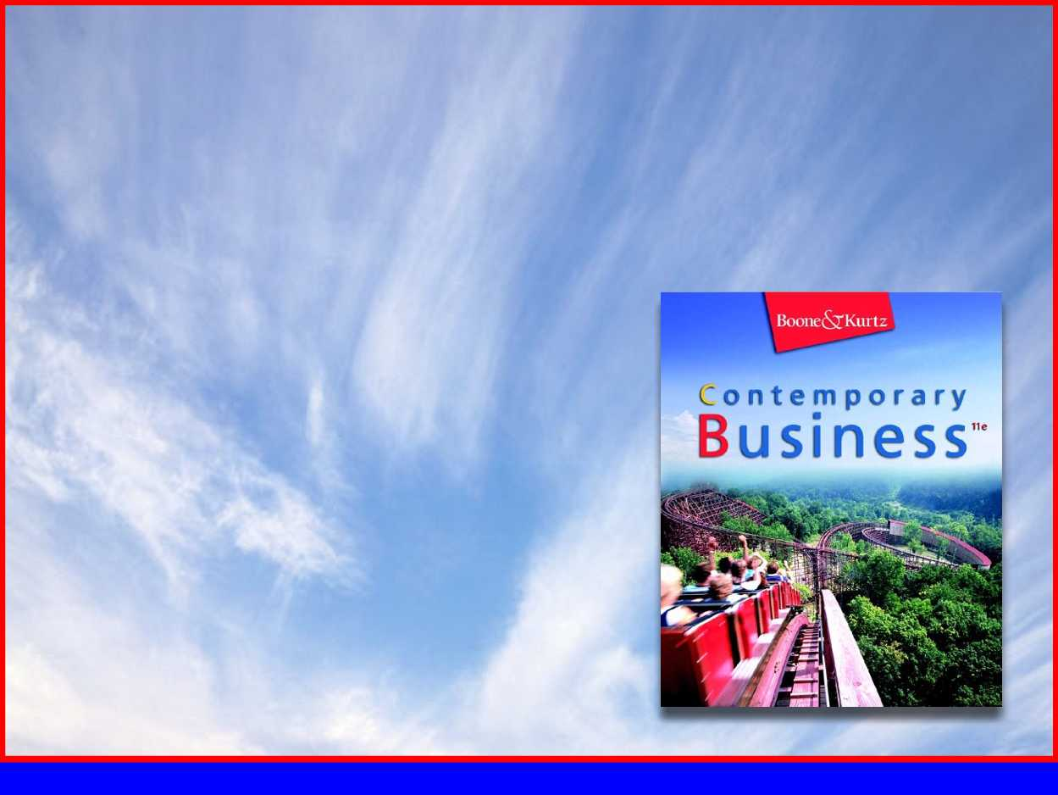
Part 4
Marketing Management

Slide 2
Chapter 13
Product and Distribution Strategies

Slide 3

Chapter Objectives
Explain the marketing conception of a product and list the components of a pStrategy strategy.
Describe the classification system for consumer and business goods and services.
Distinguish between a product mix and a product line.
IdIntermediariesiefly describe each of the four stages of the product life cycle.
List the stages of the new-product development process.
Explain how firms identify their products.
Identify and briefly describe each of the major components of an effective distribution strategy and the impact of Internet commerce on distribution channels.
Identify the various categories of distribution channels and discuss the factors that influence channel selection.

Slide 4
Product Strategy
Product—bundle of physical, service, and symbolic attributes designed to enhance buyers’ want satisfaction.
  Included in this broad definition are considerations of package design, brand names, warranties, and product image
  People don’t buy things (e.g., ¼” drill bits), they purchase what those things will provide them with (e.g. ¼” holes)
Notes:
Focusing on Benefits
1. need to focus the firm’s product design, packaging, and promotional decisions on giving customers the bundle of benefits they seek from the product.
2. Also need to focus on buyer solutions and product benefits.
Services are Products, Too
1. Services are intangible tasks that satisfy needs of final consumers or business users.
2. Most products combine both tangible goods and intangible services.

Slide 5
Product Strategy
Classifying Goods and Services
  Products can be broadly categorized as either consumer products or business products depending on who purchases them for what reasons
    Classifying Consumer Goods and Services
    Classifying Business Goods
    Classifying Services

Slide 6
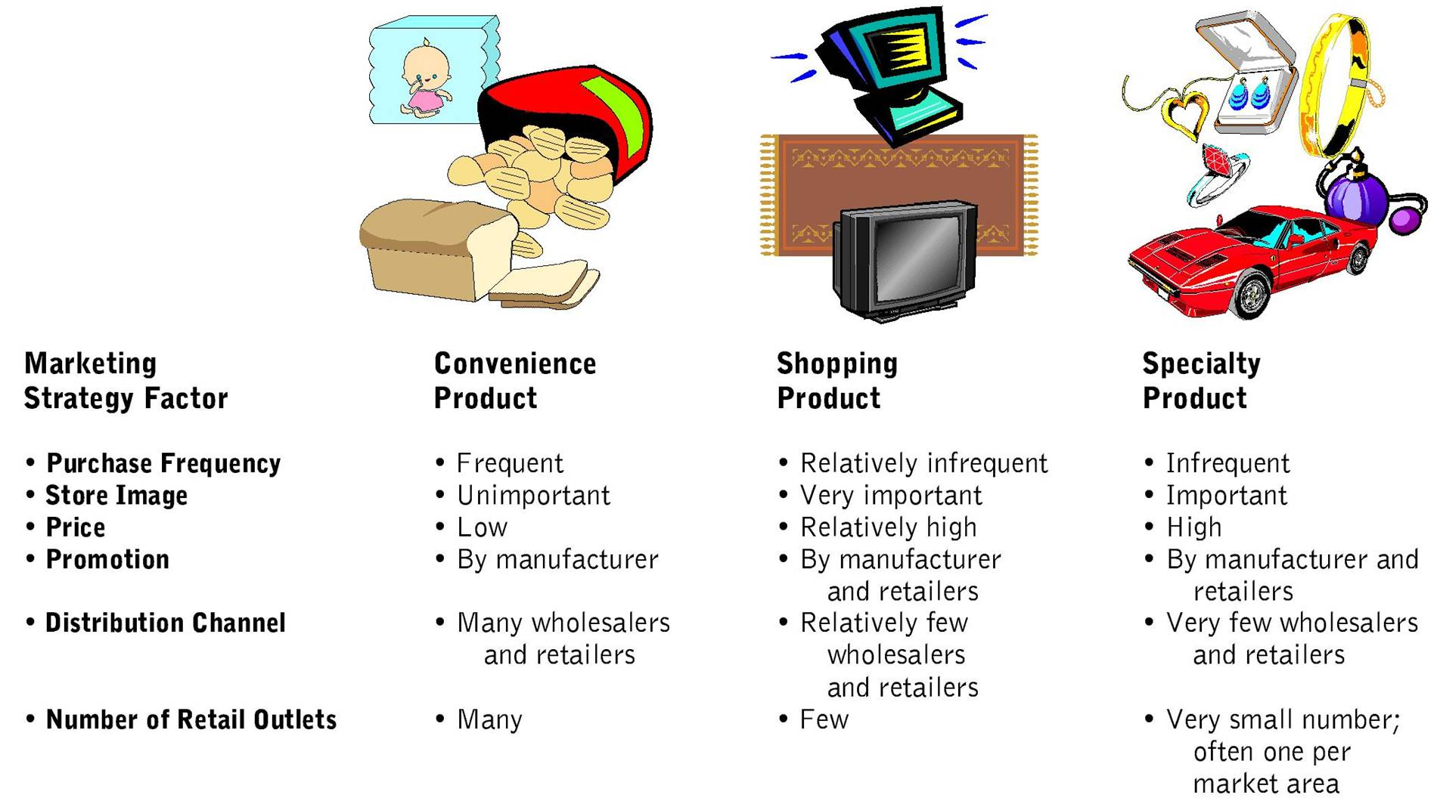
Marketing Impacts of Consumer Product Classifications
Notes:
Convenience Products
a. items that consumers purchase frequently, immediately, and with little efforts
b. examples include: newspapers, chewing gum, magazines, milk, bread and snack foods
Shopping Products
a. items that are typically purchased only after comparisons between products in competing stores to evaluate such characteristics as price, quality, style, and color
b. an example is carpeting
Speciality Products
a. those items that purchasers are willing to make special efforts to obtain
b. purchasers are already familiar with the item and see no reasonable substitute
c. tend to be expensive and are well-known brand names
d. often distributed through a limited number of exclusive dealers
e. examples include: Louis Vuitton luggage, Porche autos, designer clothing

Slide 7
Product Strategy
Classifying Business Goods
  They are classified based upon how customers use them as well as their basic characteristics
  Capital or Expense Items
    Installations
    Accessory equipment
    Component parts and materials
    Raw materials
    Supplies
Notes:
Installations
a. pieces or collections of major capital equipment
b. examples include: new factory systems, heavy machinery, and customer-made equipment
Accessory Equipment
a. capital items that are usually less expensive and shorter-lived than installation
b. examples include: hand tools, scanners, fax machines
Component Parts and Materials
a. business products that are included as part of other firms’ final products
b. may be visible, such as tires in trucks, or less visible, such as microchips in cell phones
Raw Materials
a. similar to component parts and materials, because they become inputs in the production of other firm’s final products
b. examples include: farm products such as cotton, wheat, fertilizer, cattle and milk, as well as natural materials such as iron ore, turquoise, lumber and coal
Supplies
a. expense items that are used in a firm’s daily operation and do not become part of the final product
b. examples include: paper, pens, paper clips, light bulbs, and cleaning supplies

Slide 8
Product Strategy
Classifying Services
  Like tangible goods, services can be distinguished on the basis of their buyers and the ways they use the products
  Services can also be convenience, shopping, or specialty products depending on the buying patterns of consumers
Notes:
1. Like tangible goods, services could also be convenience, shopping or specialty depending on the buying patterns of customers.
2. Additional characteristics distinguish them from goods, including:
a. Services, unlike goods, are intangible.
b. From the buyer’s perspective, the service provider is the service; the two are inseparable.
c. Services are perishable; cannot be stockpiles in inventory.
d. Since they must meet individual customers’ needs, services are difficult to standardize.
e. The customer often plays a major role in marketing, producing and distributing a service.
f. Service quality shows wide variations, some of the tied directly to price.

Slide 9
Product Strategy
Marketing Strategy Implications
  Classifying products is a useful tool in developing marketing strategies
  After classifying an item as a shopping product, marketers gain an immediate idea of its promotion, pricing, and distribution needs

Slide 10
Product Strategy
Product Lines and Product Mix
  Product Line—group of related products that are physically similar or are intended for the same market.
  Product Mix—company’s assortment of product lines and individual offerings.
Notes:
A. A group of related products marked by physical similarities or intended for a similar market.
B. Service providers also use the product line and product mix terminology.
C. Product mix must be continually assessed to ensure company growth, satisfaction of changing consumer needs and wants, and to respond to competing offerings.
D. Successful product mixes and product lines undergo constant changes.
E. A firm might also gain by canceling a product line that is not meeting the business’ objective.

Slide 11
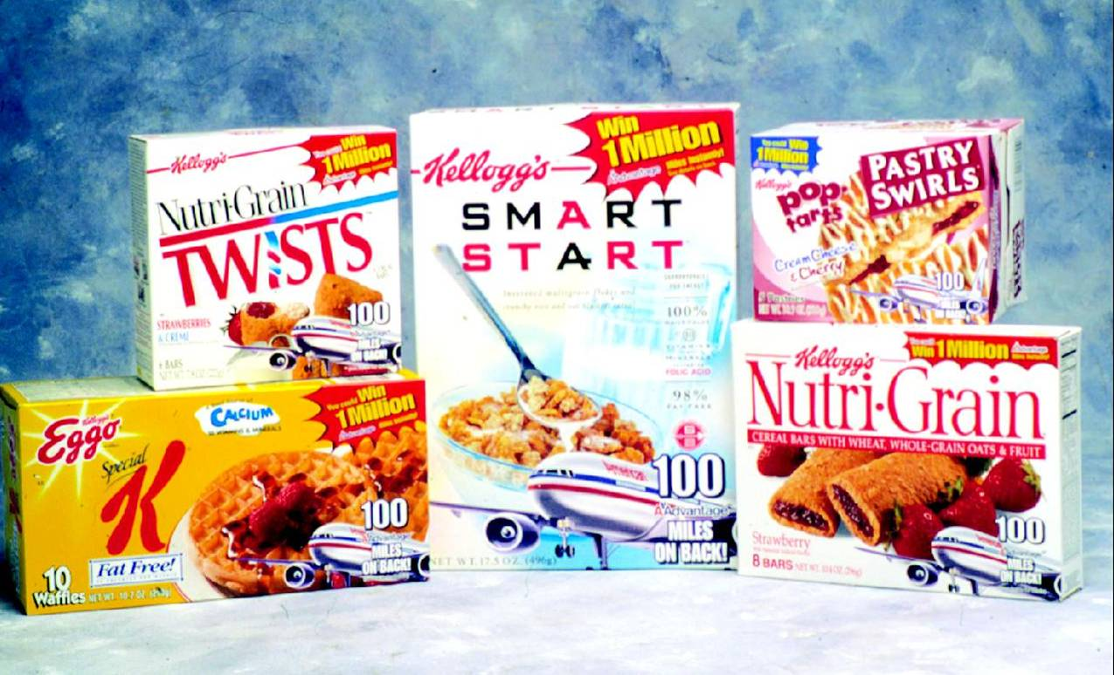
Product Mix

Slide 12
Product Life Cycle
Product Life Cycle—four basic stages through which a successful product progresses.
  Introduction
  Growth
  Maturity
  Decline
Notes:
1. All products pass through these stages.
2. Products remain at the various stages for different amounts of time.
3. Increasing competition and rapid improvements in technology compress the life cycles of many products.
4. Promotional emphasis shifts from providing product information in the early stages to heavy brand promotion later on.

Slide 13
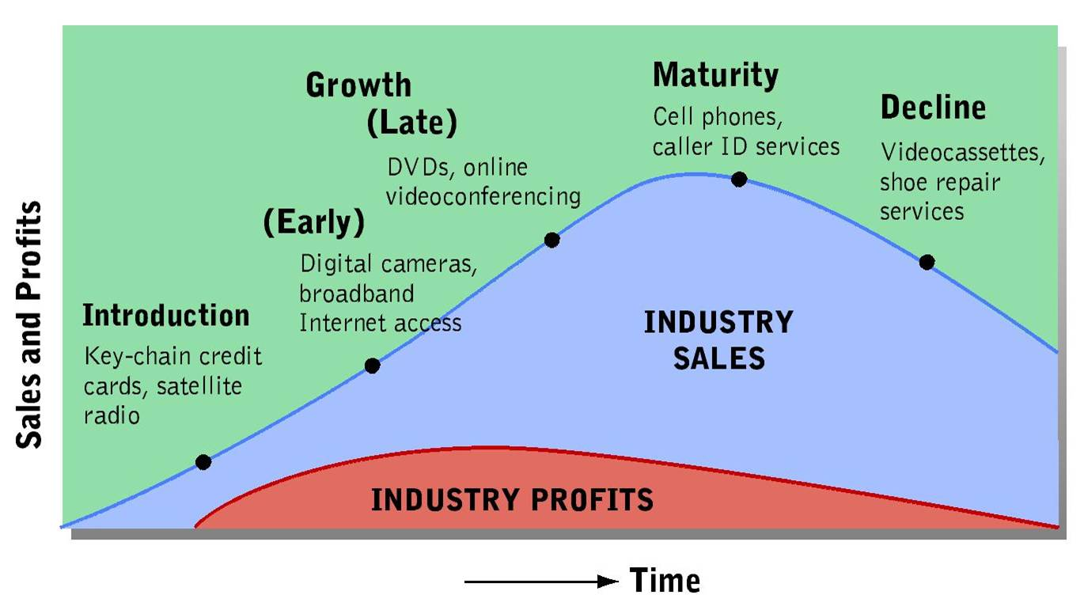
Stages in the Product Life Cycle

Slide 14
Product Life Cycle
Stages of the Product Life Cycle
  Introduction
    Firm attempts to build demand for its new offering
    Promotional campaigns concentrate on features, uses, and benefits
    Financial losses are common due to low initial sales and heavy promotional costs
Notes:
a. The firm attempts to build a demand for its new offering.
b. Due to lack of awareness and understanding about the product, initial work may concentrate on informing the market about the item and explaining its features, uses, and benefits.
c. Firms typically incur financial losses during this stage due to low initial sales, expenses involved in developing the new product, and the promotional costs.

Slide 15
Product Life Cycle
Stages of the Product Life Cycle
  Growth
    Sales climb quickly
    Firm usually begins to realize profits due to higher sales volume
    Marketing efforts continue to focus on establishing the product in the market and building brand awareness
    Later in the growth stage, the strategy shifts to building loyalty
    Additional spending on product adaptation, promotion and distribution, along with lower prices may be necessary
Notes:
a. Sales climb quickly in this stage and profits are beginning to be generated.
b. New customers join the early users, who are now repurchasing the items.
c. Personal referrals and continued promotion induce others.
d. During early growth, marketing efforts continue to focus on establishing the product in the market and building brand awareness.
e. Later, the strategy shifts to building loyalty among consumers and intermediaries.
f. Sales continue to grow, but at a slower rate.
g. To expand its share of a growing market, a firm may change styles, target specific segments with different versions, or lower prices

Slide 16
Product Life Cycle
Stages of the Product Life Cycle
  Maturity
    Industry sales continue to grow, but eventually reach a plateau
    Companies emphasize market segmentation – often resulting in an oversupply of the product
    Competition intensifies, and profits begin to decline
    Some firms reduce prices and/or spend heavily on promotion
Notes:
a. Sales continue growing early in this stage, but eventually they reach a saturation level.
b. Market segmentation is emphasized during this stage, frequently adding new product variations aimed at different customer groups.
c. Often results in an oversupply of the product in an already saturated market.
d. Competition intensifies, as increasing a firms’ market share now requires taking sales away from competitors.
e. Some marketers reduce prices.
f. Firms spend heavily on promotion to protect their market shares and to distinguish their products from competitors.
g. Efforts are made to extend the product life cycle.

Slide 17
Product Life Cycle
Stages of the Product Life Cycle
  Decline
    Innovations or shifts in consumer preferences cause an absolute decline in industry sales
    Industry as a whole does not generate profits, though some firms can prosper
    Prices tend to hold steady if a loyal market segment continues to buy the product
    If the firm is selling to consumers who are loyal, they can skip most of the usual advertising
Notes:
a. Industry sales fall steadily, as changing customer preferences, or introductions of a significant product innovation, shifts purchasing patterns.
b. The industry does not generate profits during the decline, some businesses prosper as their competitors leave the market.
c. Price tends to hold steady if a loyal market segment continues.
d. Reluctance to invest in significant changes in a product’s style, design or other features.

Slide 18
Product Life Cycle
Marketing Strategy Implications of the Product Life Cycle
  Product life cycle concept is an invaluable management tool for designing a marketing strategy at different life-cycle stages
Notes:
1. Each element of the marketing mix may require adjustments as the product moves through the life cycle.
2. Four techniques are available, including:
•product variation- upgrades, changes in the product to appeal to different age groups of consumers
•packaging variation- can support product variations or stand on their own as part of a marketing strategy
•price changes- used to tempt first-time consumers and maintain repeat users
•changes in distribution- useful in responding to new opportunities or when facing strong competition

Slide 19
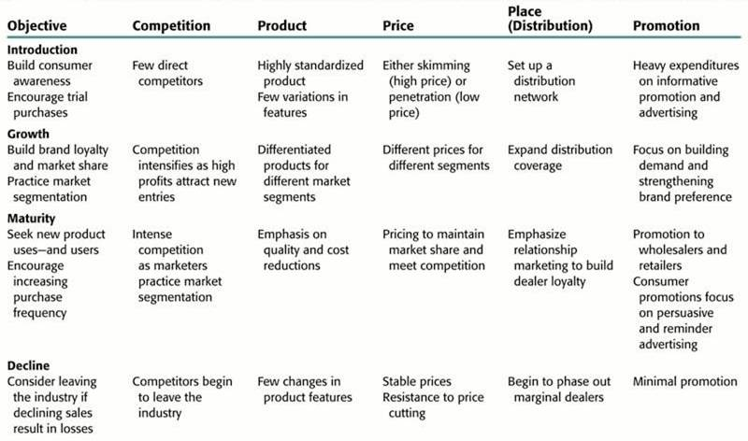
Marketing Strategy Implications of the Product Life Cycle

Slide 20
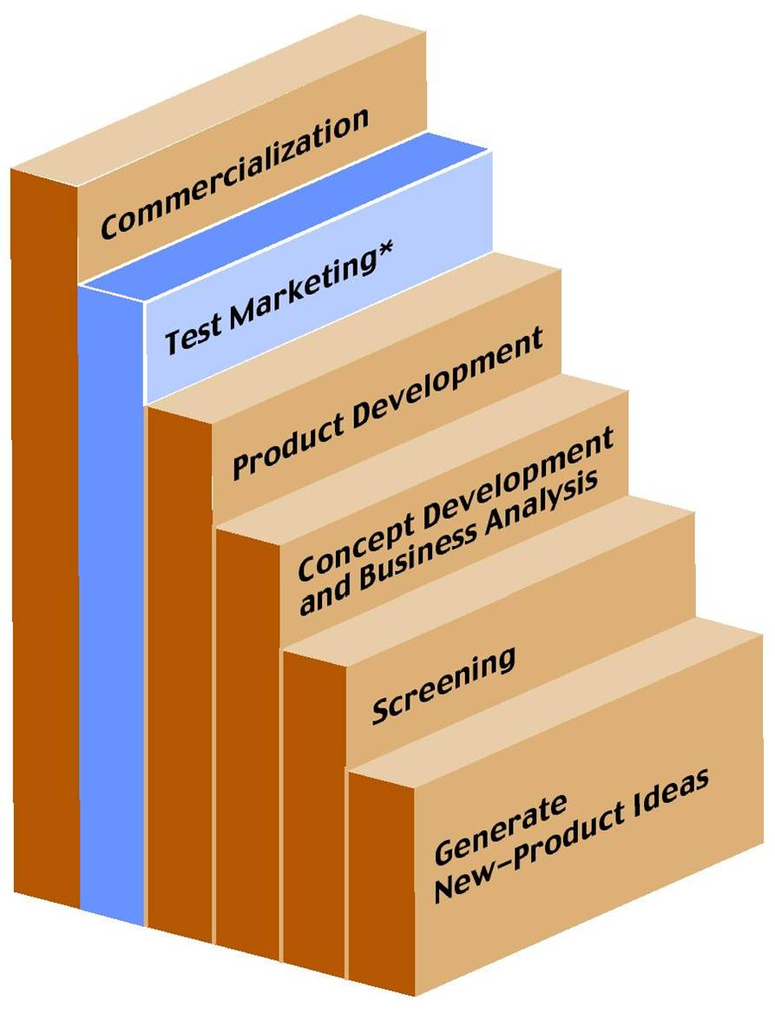
Product Life Cycle
Stages in New-Product Development
  New products are the lifeblood of any organization
  Firms must periodically add new products to assure continued prosperity
Notes:
The stages of the new-product development are idea generation, screening, business analysis, prototype or service process development, testing, and commercialization.
At each stage, marketers must decide whether to continue to the next stage, modify the new product, or discontinue the development process.

Slide 21
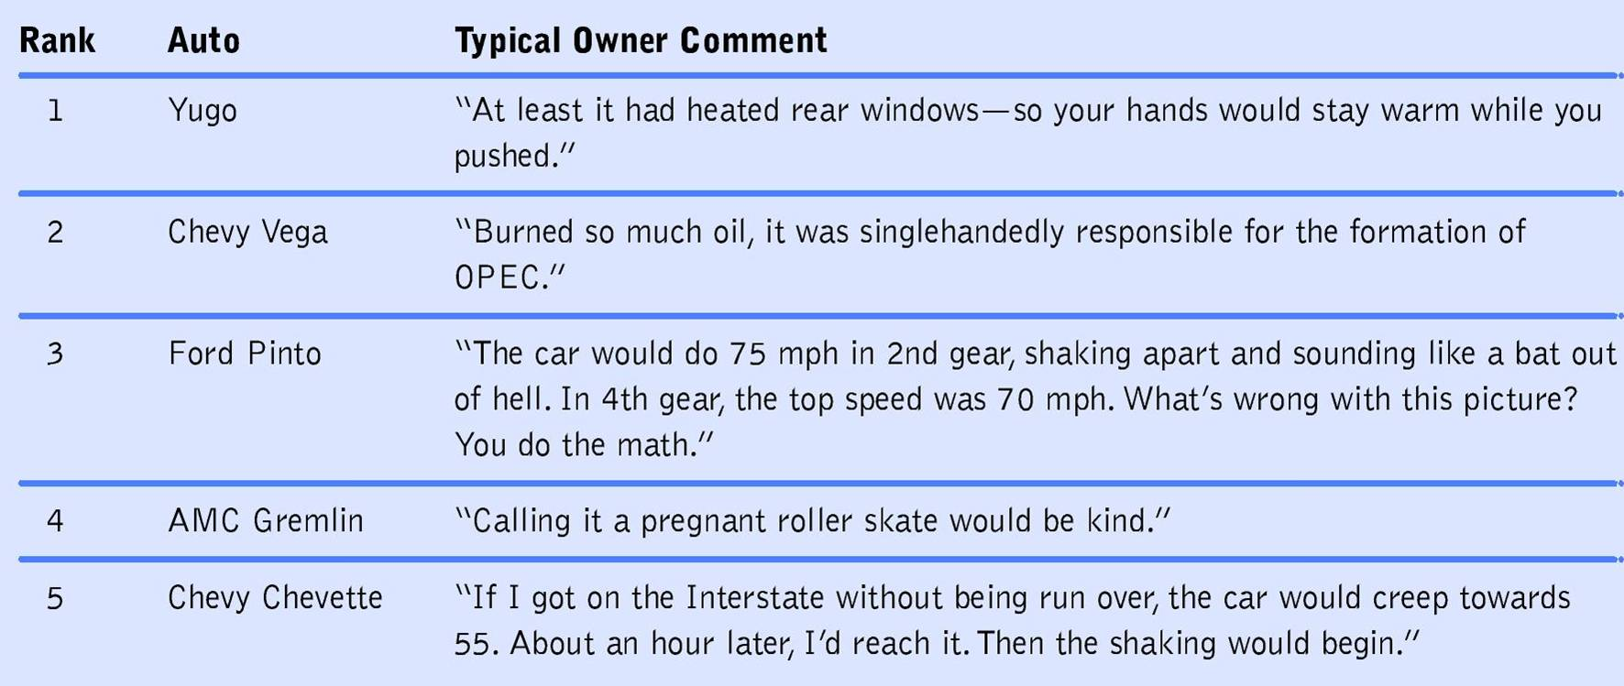
The Five Worst Cars of the Millennium

Slide 22
Product Life Cycle
Stages in New-Product Development
  Generating New-Product Ideas
    New product ideas come from many sources including:
      Customers
      Suppliers
      Employees
      Research scientists
      Marketing researchers
      Outside inventors
      Competing products

Slide 23
Product Life Cycle
Stages in New-Product Development
  Screening
    Marketers evaluate ideas’ commercial potential
    Checklists of development standards can be helpful at this stage
    This stage often involves representatives of different functional areas

Slide 24
Product Life Cycle
Stages in New-Product Development
  Concept Development Business Analysis
    Evaluation of whether the idea fits with the firm’s product, distribution, and promotional resources
    Marketers also assess potential sales, profits, growth rate, and competitive strengths

Slide 25
Product Life Cycle
Stages in New-Product Development
  Product Development
    Converting an idea into a physical product
    Requires interaction between development engineers and marketers
    Prototypes may go through many modifications

Slide 26
Product Life Cycle
Stages in New-Product Development
  Test marketing
    Trial introduction of a new product, supported by a complete marketing campaign, to a selected area with a population typical of the total market
    Some firms skip this stage, moving directly to full-scale commercialization
Notes:
Some firms skip test marketing and move directly to commercialization because:
a. test marketing can be expensive
b. competitors may try to skew the results by lowering prices, distributing coupons, or running special promotions
c. long-lived durable goods are seldom test marketed due to the major financial investments required
d. test marketing can alert competitors to plans

Slide 27
Product Life Cycle
Stages in New-Product Development
  Commercialization
    In this stage, the firm offers its new product in the general marketplace
    The firm establishes marketing programs, production facilities, and acquaints its sales force, intermediaries, and potential customers with the new product

Slide 28
Product Identification
Brand—name, term sign, symbol, design, or some combination that identifies the products of a firm and distinguishes them from competitive offerings.
Brand name—the part of a brand consisting of words or letters that form a name that identifies and distinguishes an offering from those of competitors
Trademark—brand with legal protection against another company’s use (can include pictorial designs, slogans, packaging elements, and product features)

Slide 29
Product Identification
Selecting an Effective Brand Name
  Should communicate appropriate product images
  Must be easy to pronounce, recognize, and remember
  Best if Short
  Should Attract Attention
Notes:
1. Promote buyer awareness of the nature and quality of competing products
2. Must communicate appropriate product images to consumers
3. Some brand names are too effective, such as aspirin, escalator or zipper, the original owner looses exclusive claim to the brand name.
4. Typically precautions are taken to protect brand names:
a. trademark laws state that brand names cannot contain word in general use, such as television
b. no organization can claim exclusive use of generic words
5. It has become increasingly difficult to coin effective brand names as competitions has increased.
6. Computer databases and software systems are helpful in identifying brand names.
7. The Internet creates additional challenges by making any Web site a worldwide presence.

Slide 30
Product Identification
Brand Categories
  Manufacturer’s (or national) brands— brand offered and promoted by a manufacturer or producer
  Private (or store) brand—identifies a product that is not linked to the manufacturer, but instead carries the label of a retailer or wholesaler
Notes:
Manufacturer’s or National Brands
a. a brand offered and promoted by a manufacturer or producer
b. examples include: Chanel, Swatch, Bic and Crest
c. often tend to be priced higher when compared to their generic equivalent
Private or Store Brand
a. identifies a product that is not linked to a manufacturer
b. instead carries the name of the wholesaler or retailer
c. K-Mart’s Martha Stewart line of products is a well known private brand
d. the growth of these brands parallels that of the growth of chain stores

Slide 31
Product Identification
Brand Categories
  Some firms market their goods and services without branding them. Such items are called generic products or generic brands
  They are characterized by plain packaging, minimal labeling, and little or no advertising
Notes:
a. Typically meet only minimal quality standards.
b. Usually are priced considerably lower than comparable manufacturers’ and private brands.

Slide 32
Product Identification
Brand Categories
  Family Brand—single brand name that identifies several related products
  Individual Brands—giving a different brand name to each product within a product line
Notes:
Family Brand
a. a single brand name that identifies several related products
b. when introducing a new product customers and retailers recognize the familiar brand name even though they may not have purchased that particular item before
c. examples include: Spalding and Arm & Hammer
Individual Brands
a. give a different brand name to each product within a line
b. each brand targets a unique market segment
c. examples include: Aim, Close Up, and Pepsodent, which are all produced by Lever Bros.

Slide 33
Product Identification
Brand Loyalty and Brand Equity
  Brand Loyalty—measured in three stages– recognition, preference, and insistence
  Brand Recognition—brand acceptance strong enough that the consumer is aware of a brand, but not enough to cause a preference over competing brands
Notes:
The marketer’s task is to generate the maximum consumer loyalty for a brand.
Several methods for measuring brand loyalty exist, including:
Brand Recognition
a. Brand acceptance strong enough that the consumer is aware of a brand, but not enough to cause a preference over competing brands
b. Advertising and distributing free samples are the most common ways to increase brand recognition.
c. Building brand recognition is a particular challenge for e-commerce businesses.

Slide 34
Product Identification
Brand Loyalty and Brand Equity
  Brand Preference—occurs when a consumer chooses one firm’s brand, when it is available, over a competitors
  Brand Insistence—when the consumer will accept no substitute for a preferred brand
Notes:
Brand Preference
a. occurs when a consumer chooses one firm’s brand, when it is available, over a competitor’s
b. At this stage, consumers rely on previous experience when selecting a product.
Brand Insistence
a. the ultimate degree of brand loyalty
b. The consumer will accept no substitute for a preferred brand.
c. If the preferred brand is not readily available, the consumer will actively seek another source.
d. A product at this stage has achieved a monopoly position with consumers.
e. Few products achieve this level.

Slide 35
Product Identification
Brand Loyalty and Brand Equity
  Brand Equity—added value that a certain brand name gives to a product
    Brand Awareness
    Brand Association
Notes:
Brand Equity
Refers to the added value that a widely respected, highly successful name gives to a product in the marketplace.
The value results from a combination of factors, including:
a. awareness b. loyalty c. perceived quality
d. any feeling or images the customer associates with the brand
Brand awareness- the product is the first one that comes to mind
Brand association- a link between a brand and other favorable images
a. Since a product commands a comparatively large market share, high brand equity offers financial advantages to a firm.
b. Brand loyalty often reduces consumers’ price sensitivity, thus creating the potential for higher profits.
c. Building favorable brand equity is difficult.
d. Typically a brand manager is assigned the task of managing a brand’s marketing strategies.

Slide 36

Product Identification
Brand Loyalty and Brand Equity
  Managing the Brand
    Responsibility of a brand manager or product manager at the typical large company
    Category Manager

Slide 37
Product Identification
Packages and Labels
  Packaging helps to achieve several goals:
    Protects against damage, spoilage, and pilferage
    Assists in marketing the product
    Cost-effectiveness
Notes:
A. The original purpose of packaging was to protect the products against damage, spoilage and theft; labeling was primarily informative.
B. Packaging and labeling has become increasingly important over the years.
C. Represents one of the biggest cost elements for many consumer products
D. Packaging serves:
protection
assisting in marketing the product
cost-effectiveness
improve product usage, such as using the packaging of a printer cartridge to return the used cartridge for recycling
reduce waste
meet environmental standards
reduce theft

Slide 38
Product Identification
Packages and Labels
  Label—descriptive part of a product’s package that lists the brand name or symbol, name and address of the manufacturer or distributor, product composition and size, nutritional information for food products, and recommended uses

Slide 39
Product Identification
Packages and Labels
  Effective labeling serves several functions:
    Attracts buyer’s attention
    Describes package contents
    Conveys product benefits
    Provides information on warranties, warnings, and other consumer matters
    Gives and indication of price, value, and uses

Slide 40
Distribution Strategy
Distribution Channels
  Distribution Channel—path through which products - and legal ownership of them - flow from producer to consumers or business users.
  Physical Distribution—actual movement of products from producer to consumer or business users.
Notes:
A. Essential to a firm’s marketing efforts
B. Distribution channels - the paths through which products -- and the legal ownership of them -- flow from producer to consumer or business buyers
C. should support the firm’s overall marketing strategy by providing ultimate customers with convenient ways to obtain goods and services desired

Slide 41
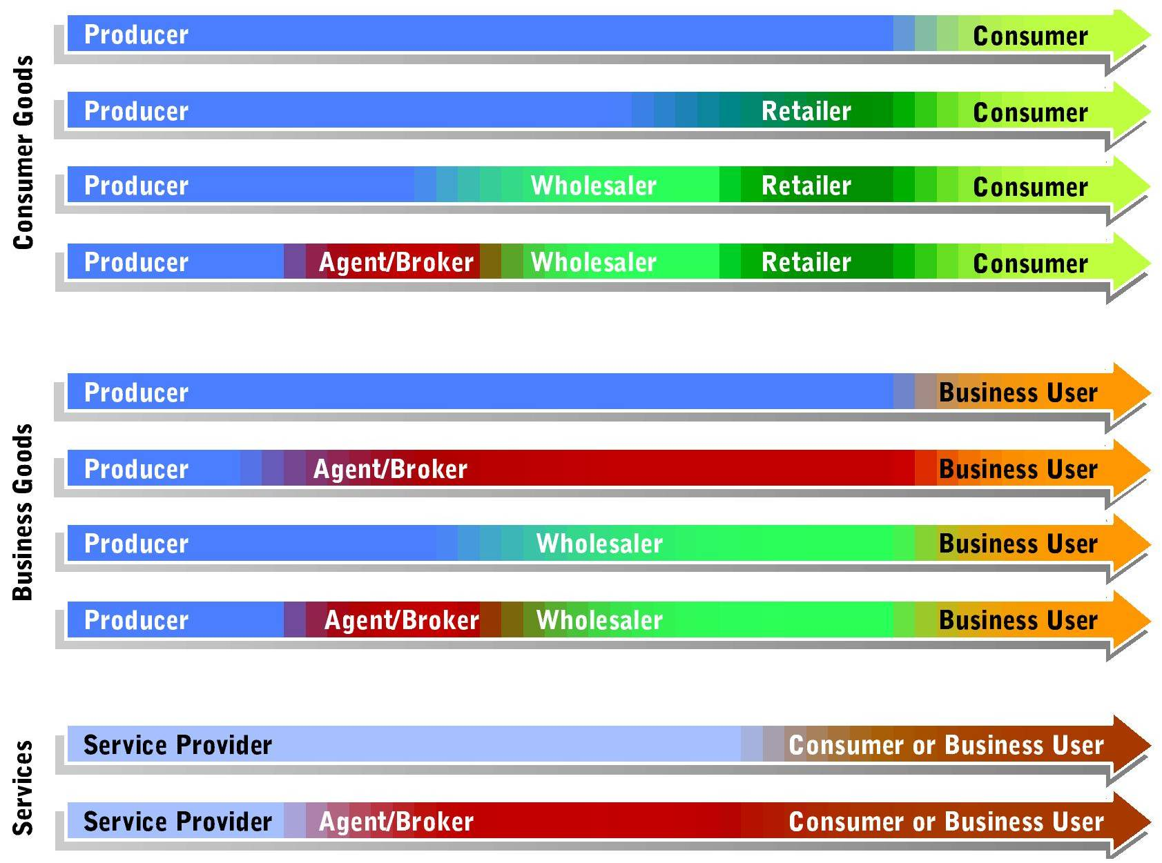
Alternative Distribution Channels

Slide 42
Distribution Strategy
Distribution Channels
  Direct Distribution
    Shortest and simplest means of connecting producers and customers
    Advantageous when marketing relatively expensive, complex goods that require demonstration
  Distribution Channels Using Marketing Intermediaries
Notes:
Direct Distribution
a. goods and services move directly from their production points to business buyers or consumers
b. most common in the business-to-business (B2B) market
c. serves consumers who buy fresh fruits and vegetables at rural roadside stands
d. services range from banking and quick oil changes
e. offers advantages in marketing relatively expensive, complex products that might require demonstrations
f. strengths are especially important in B2B market
g. most major industrial installations, accessory equipment, component parts, business services and even raw materials are typically marketed via direct distribution
h. The Internet is making direct distribution an attractive option.
i. Some products can be delivered, as well as sold on the Internet.

Slide 43
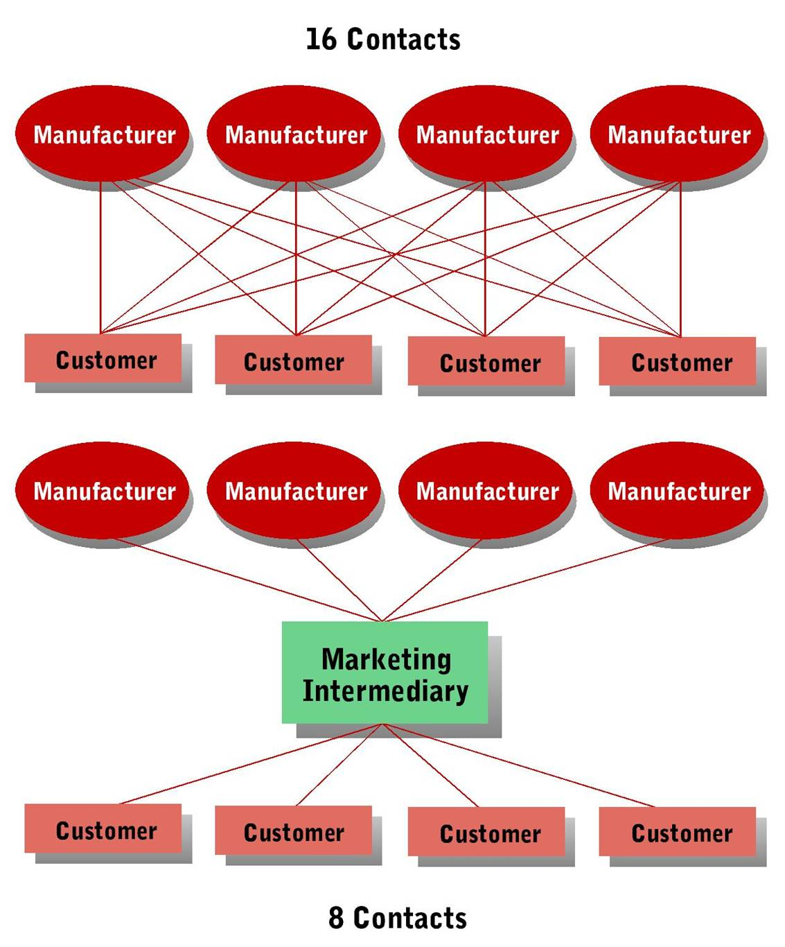
Reducing Transactions through Marketing Intermediaries

Slide 44
Distribution Strategy
Distribution Channels
  Distribution Channels Using Marketing Intermediaries
    Retailer—channel member that sells goods and services to individuals for their own use rather than for resale.
    Wholesaling Intermediary—channel member that sells goods primarily to retailers, other wholesalers, or business users.

Slide 45
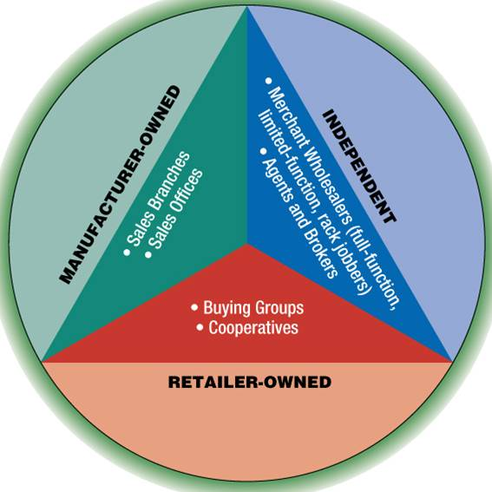
Wholesaling
Wholesaler—distribution channel member that sell primarily to retailers, other wholesalers, or business users.

Slide 46
Wholesaling
Manufacturer-Owned Wholesaling Intermediaries
  Two main types of manufacturer-owned wholesaling intermediaries
    Sales branches
    Sales offices
Notes:
Manufacturer-Owner Wholesaling Intermediaries
a. may decide to distribute goods directly through company-owned facilities to maintain control of distribution or customer service
b. Two main types, including:
•sales branches - stock the products they distribute and fill orders from their inventories; provide offices for sales representatives
•sales offices - an office for a producer’s salespeople who represent products in a particular territory; do not store or warehouse inventory

Slide 47
Wholesaling
Independent Wholesaling Intermediaries
  Classified as either merchant wholesalers or agents and brokers depending on whether they take title to the products they handle
    Merchant wholesalers
    Full-function
    Rack-jobber
    Limited-function
    Drop-shipper
    Agents and Brokers
Notes:
1. Merchant Wholesalers: independently owned wholesaling intermediaries who take title of goods they handle; full-function merchant wholesalers provide a complete assortment of services
2. Rack jobbers - a sub-category who stocks, displays and services particular retail products
3. Limited-function merchant wholesalers - take legal title, but provide fewer services
4. Drop shipper - one example, operate in industries categorized by bulky products where there is no single producer
5. Agents and Brokers
may or may not take possession of the goods they handle
never take the titles
6. Manufacturers’ agents
also known as manufacturers’ reps or independent reps
act as independent sales forces
represent manufacturers or related, non-competing products
receive sales commissions
7. Sales agents - typically represent larger territories than manufacturers’ agents
8. Commission merchants - sell agricultural products for framers
9. Auction houses - allow potential buyers to inspect merchandise prior to bidding on it

Slide 48
Wholesaling
Retailer-Owned Cooperative and Buying Offices
  Retailers sometimes band together to form their own wholesaling organizations in the form of a
    Buying group
    Cooperative
  Set up to reduce costs or to provide some special service not readily available in the marketplace.

Slide 49
Retailing
Retailer—channel member that sells goods and services to individuals for their own use rather than for resale.
Notes:
The final elements in the distribution channel.

Slide 50
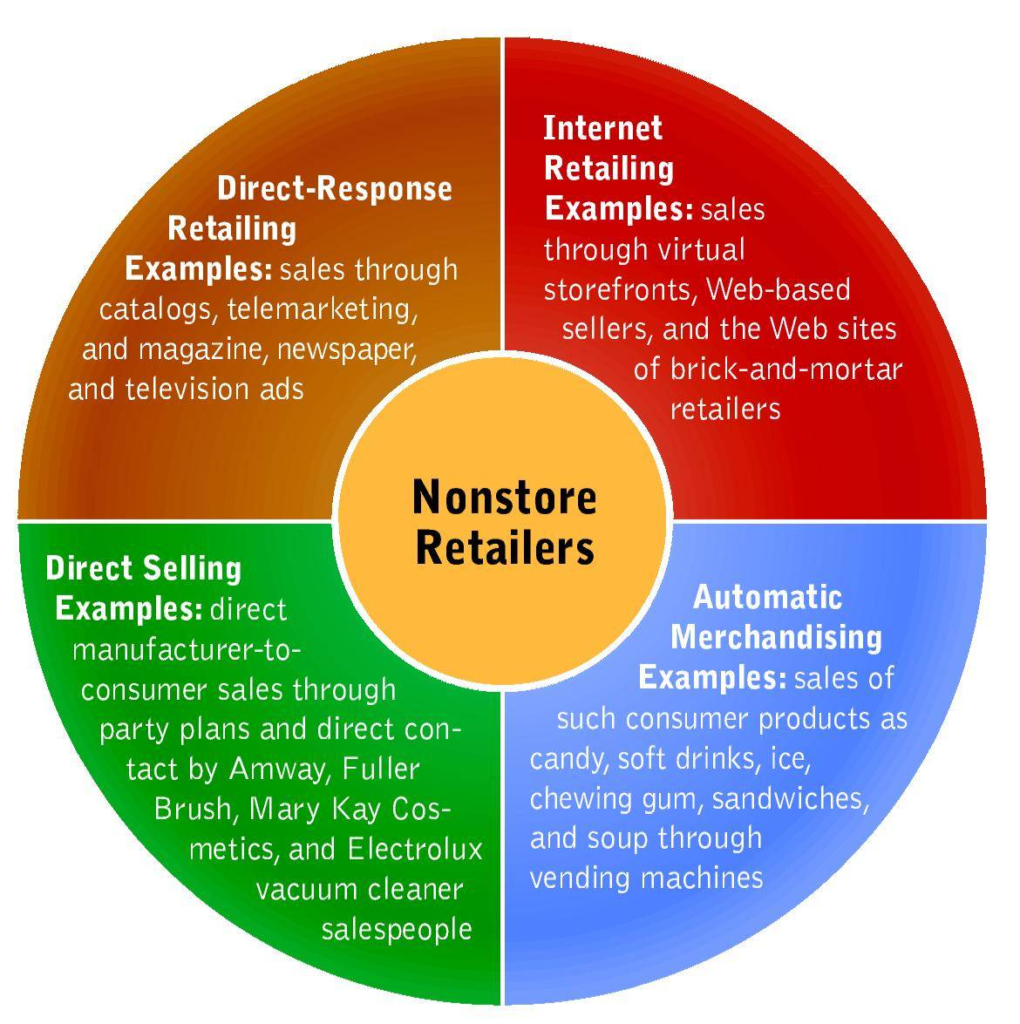
Types of Nonstore Retailers

Slide 51
Retailing
Store Retailers
  Wheel of Retailing—theory explaining changes in retailing as a process in which new retailers gain a competitive foothold by offering low prices and limited services, then add services and raise prices, creating opportunities for new low-price competitors.
Notes:
The specific theory states:
a. New types of retailing enter the market and gain a competitive foothold by offering low prices and limited services.
b. Once established, these companies add more services forcing them to raise prices.
c. This makes them vulnerable to new retailing options that compete with their lower prices.

Slide 52
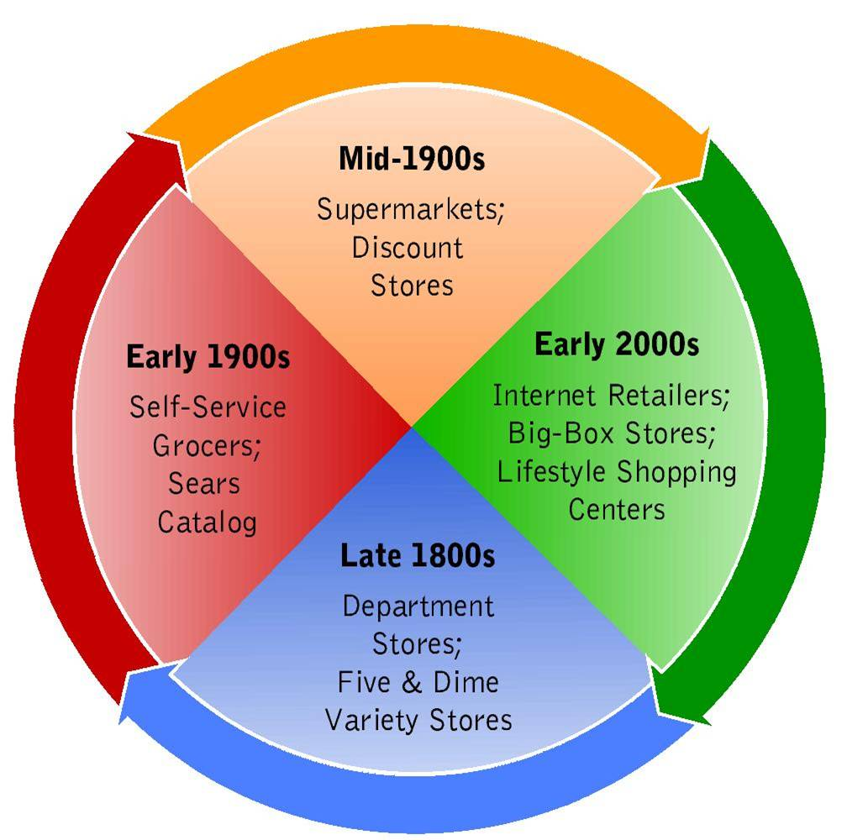
The Wheel of Retailing

Slide 53
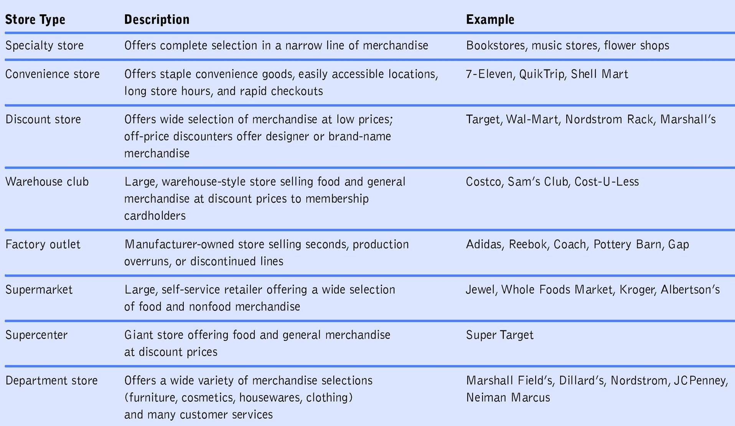
Types of Retail Stores

Slide 54
Retailing
How Retailers Compete
  Identifying a Target Market
    Requires careful evaluation of:
      Size and profit potential of the chosen market segment
      Current level of competition for the segment’s business

Slide 55
Retailing
How Retailers Compete
  Selecting a Product Strategy
    Determining the best mix of merchandise to carry to satisfy the target market
    Deciding on
      General product categories
      Product Lines
      Variety

Slide 56
Retailing
How Retailers Compete
  Shaping a Customer Service Strategy
    Some stores offer customers a wide variety of services, such as gift wrapping, alterations, return privileges, interior design services and delivery
    Less obvious service includes making shopping easy, fast and convenient
    Alternative is to offer only bare-bones service – stressing low prices instead

Slide 57
Retailing
How Retailers Compete
  Selecting a Pricing Strategy
    Based on costs and services offered to customers
    Pricing can play a major role in consumer's perceptions of a retailer
    Pricing strategy must support the firm’s overall marketing objectives and policies

Slide 58
Retailing
How Retailers Compete
  Choosing a Location
    Can make the difference between success and failure
    Depends on the retailer’s size, financial resources, product offerings, competition, and target market
    Planned shopping center—group of retail stores planned, coordinated, and marketed as a unit to shoppers in a geographic trade area

Slide 59
Retailing
How Retailers Compete
  Building a Promotional Strategy
    Advertisements and other promotions developed to both:
      Stimulate demand
      Provide information
    Store personnel also play a key role in a retailer’s promotional strategy

Slide 60
Retailing
How Retailers Compete
  Creating a Store Atmosphere
    Store Atmospherics—the physical characteristics of a store and its amenities -- influences consumer perceptions
      Begins with the store’s exterior
      Interior elements include layout, merchandise, presentation, lighting, color, sounds, and cleanliness

Slide 61
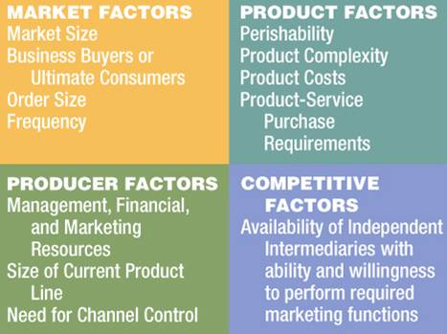
Distribution Channel Decisions and Physical Distribution
Selecting Distribution Channels

Slide 62
Distribution Channel Decisions and Physical Distribution
Selecting Distribution Channels
  Distribution Intensity—the number of intermediaries or outlets through which a manufacturer distributes its goods
  Levels of intensity include:
    Intensive distribution
    Selective distribution
    Exclusive distribution
Notes:
Intensive distribution
a. places a firm’s product in nearly every available outlet
b. suits low-priced, convenience goods, requires cooperation by many intermediaries to achieve market coverage
Selective distribution
a. manufacturer selects only a limited number of retailers
b. can reduce total marketing costs
c. establishes strong working relationships within the distribution channel
Exclusive distribution
a. involves limited market coverage by a single retailer or wholesaler in a specific geographic territory
b. suits relatively expensive specialty products
c. Retailers are carefully selected to enhance the products’ image.
d. Well-trained sales and service personnel are needed to contribute to customer satisfaction.
e. may sacrifice market coverage by granting exclusive coverage, but usually pays off in developing and maintaining image of quality and prestige

Slide 63
Distribution Channel Decisions and Physical Distribution
Logistics and Physical Distribution
  Supply Chain—complete sequence of suppliers that contribute to creating and delivering a good or service to business users and final consumers.
  Logistics—activities involved in controlling the flow of goods, services, and information among members of the supply chain.
Notes:
Creates the final decision in the supply chain--the complete sequence of suppliers that contribute to creating and delivering a good or service to business users and final consumers
1. Begins with raw materials
2. Continues with the actual production activities
3. Ends as finished goods move through the producer’s distribution channels to end users
Logistics - the process of actually coordinating the flow of goods, services and information among members of the supply chain
1. Businesses spend billions on logistics management, looking to add value throughout their supply chains.
2. Logistics and supply chain management also gain importance as international trade increases

Slide 64
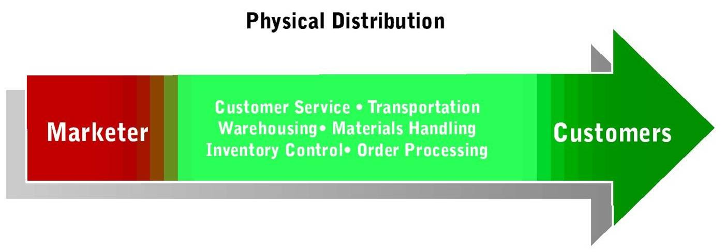
Distribution Channel Decisions and Physical Distribution
Logistics and Physical Distribution
  Physical Distribution—activities aimed at efficiently moving finished goods from the production line to the consumer
  Elements of a Physical Distribution System
Notes:
1. The activities aimed at efficiently moving finished goods from the production line to the consumer
2. Not really interchangeable with transportation; often incorrectly used that way
3. Physical distribution is a broader concept, that includes transportation and numerous elements that help link buyers and sellers.
4. When effectively managed, increases customer satisfaction by ensuring reliable movement of products through the supply chain.
5. Begins by establishing customer service standards - the quantitative guidelines set by a firm to specify the quality of service it intends to provide for its customers.
6. Transporting goods: railroads, motor carriers, air freight, water carriers, pipelines, intermodal transportation

Slide 65
Distribution Channel Decisions and Physical Distribution
Logistics and Physical Distribution
  Warehousing—storing products as they move through the distribution channel
    Storage warehouses
    Distribution warehouses
  Materials Handling
  Order Processing (Fulfillment)
  Vendor-Managed Inventory
Notes:
Two types of warehouses, including:
•storage warehouse - hold goods for moderate to long periods to balance supply and demand between producers and purchasers
•distribution warehouse - temporary storage facilities, often holding goods for 24 hours or less
Materials Handling
a. The physical distribution activity that moves items within plants, warehouses, transportation terminals, and stores.
b. Costs rise every time an item is handled.
c. Techniques are used to help firms accomplish the goal of only taking steps that add value, including:
•unitization - combining as many packages as possible into one load to be handled by a single truck or forklift
•containerization - collects packages, usually from several unitized loads, into a compact form that is relatively easy to transfer
Inventory Control
a. Involves balancing the priority of limiting costs of holding stock with meeting customer demand through a variety of management methods
b. Advance computer processing, large retailers are no longer just managing inventory, but rather the entire supply chain
Order Processing or Fulfillment
a. Includes all the tasks required to prepare customer orders for shipment
b. Involves the steps of receiving shipments, as well

Slide 66
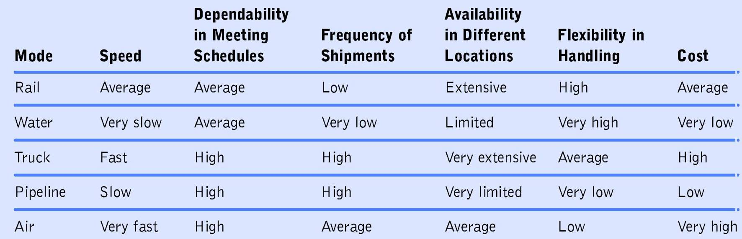
Distribution Channel Decisions and Physical Distribution
Logistics and Physical Distribution
  Comparison of Transportation Modes

Slide 67
Distribution Channel Decisions and Physical Distribution
Logistics and Physical Distribution
  Customer Service
    Customer service standards—the quantitative guidelines set by a firm to specify the quality of service it intends to provide for its customers

